Slide 1
Machine Learning Server
Part 8

Slide 2


Machine Learning Server Web Services
Easy Consumption
Explore and consume services in R/Python directly
Easy Deployment
Turn analytics into web services in one line of code
Data Scientist
Data Scientist
Admin
R or Python Client
Microsoft R Client
(mrsdeploy package)
publishService()
Services / Sessions
getService()
service.deploy()
Machine Learning Server
Python Client
(Azureml-model-management-sdk)
REST API calls
Easy Setup
In-cloud or on-premises, cross-platform
Adding nodes to scale
High availability & load balancing
Remote execution server
Apps
Easy Integration
Swagger-based APIs: easy to consume with any programming language
Developer

Slide 3
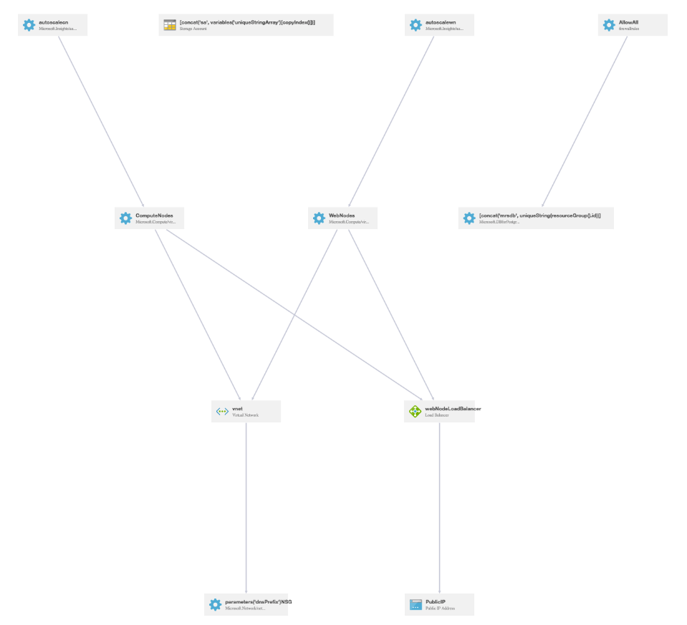
Deployment Options
1-box for development
Cluster with auto-scaling in production
Windows + SQL Azure
Linux + Postgres on Azure

Slide 4
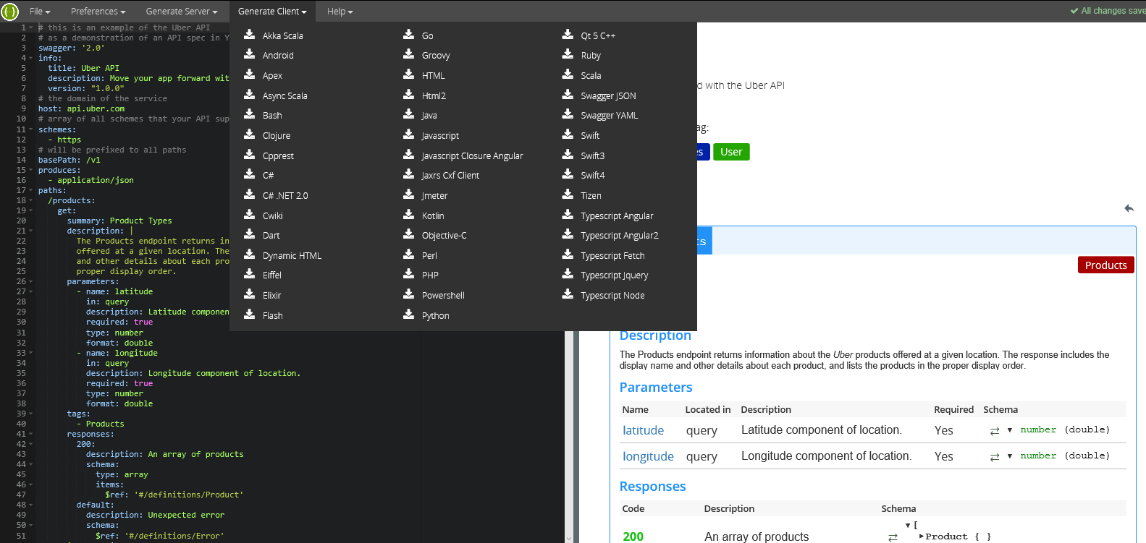
Swagger Power

Slide 5
Boost up scoring performance with realtime web services
Realtime web service vs. Standard web service
As low as <10ms latency
10X or even 100X faster than standard web services
Impact by algorithm complexity
Algos | Real time (ms) | Standard (ms)
RxLogit (model size 2K) | 3.5 | 39.2
RxNeuralNet (model size 8K) | 2.5 | 122.0
Why this fast?
Score with native code, no need for R or python.
Cache the model in memory (load only once)
Impact by model size
Model Size | Real time (ms) | Standard (ms)
2 MB (RxLogisticRegression) | 5.0 | 9215.7
43 MB (RxLogisticRegression) | 5.4 | 20255.6*
* Only models built with RevoScaleR algos and MicrosoftML algos can be deployed as Realtime web services.
* Server: Standard_D3_v2 (4 CPU core, 14GB RAM)
* Compared to R services

Slide 6
Standard vs. Realtime
Standard web services execute any R or Python.
Code, models, model assets
User-defined input and output types
Realtime web services only support serialized models
Models must be created with supported functions from RevoScaleR, revoscalepy or MicrosoftML libraries
Inputs and outputs are dataframes only

Slide 7
Consuming web services
Synchronous request/response
Asynchronous batch mode
1 request to the server is turned into multiple calls
Permissions:
Authenticated users can publish / update / delete their services, list & consume others’
Admin can assign more roles and permissions
AAD integration is available.

Slide 8
Resources
Machine Learning Server documentation
Deploying Analytics as web services
Integrate services into apps
Machine Learning Server ARM templates
Machine Learning Server blogs

